Slide 1
TOPIC 1: TCP/IP Basics and Wireshark

Slide 2
OSI MODEL
OSI Model
OSI Model is Open Systems Interconnection
In 1977, international standard organization (ISO) established a committee to develop an architecture for computer communication and OSI reference model is the result of this effort.
In 1984, the OSI reference model was approved as an international standard for communications architecture.
Term “open” denotes the ability to connect any two systems which conform to the reference model and associated standards.
The OSI model describes how information or data makes its way from application programmes (such as spreadsheets) through a netword medium (such as wire) to another application programmes located on another network.
The OSI model has 7 layer.

Slide 3
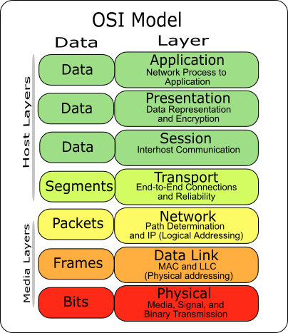
OSI MODEL
Layer of the OSI Model

Slide 4
OSI MODEL
Physical Layer
Provides physical interface for transmission of information.
Defines the transport rules of the bits on the physical connection.
Such characteristics as voltage levels, timing of voltage changes, physical data rates, maximum transmission distances, physical connectors, and other similar attributes are defined by physical layer specifications.

Slide 5
OSI MODEL
Data Link Layer
Data link layer attempts to provide reliable communication over the physical layer interface.
Analysis of data into the frame and reassemble the received frames.
Handle errors by implementing an acknowledgement and retransmission scheme.
Implement flow control.
Supports simplex, half-duplex or full-duplex communication.

Slide 6
OSI MODEL
Network Layer
Implements routing of frames (packets) through the network.
Defines the most optimum path the packet should take from the source to the destination
Handles congestion in the network.
Facilitates interconnection between heterogeneous networks (Internetworking).
Defines how to fragment a packet into smaller packets to accommodate different media.

Slide 7
OSI MODEL
Transport Layer
Provide a reliable mechanism for the exchange of data between two processes in different computers.
Ensures that the data units are delivered error free and delivered in sequence.
Ensures that there is no loss or duplication of data units.
Provides for the connection management.

Slide 8
OSI MODEL
Session Layer
Provides mechanism for controlling the dialogue between the two end systems. It defines how to start, control and end conversations (called sessions) between applications.
This layer provides mechanisms to identify the name and function of security information when transmitted over computer networks.

Slide 9
OSI MODEL
Presentation Layer
Presentation layer defines the format in which the data is to be exchanged between the two communicating entities.
Also handles data compression and data encryption (cryptography).

Slide 10
OSI MODEL
Application Layer
Application layer interacts with application programs and is the highest level of OSI model.
Application layer contains management functions to support distributed applications.
Examples of application layer are applications such as Web Server, FTP Server, Mail server …

Slide 11
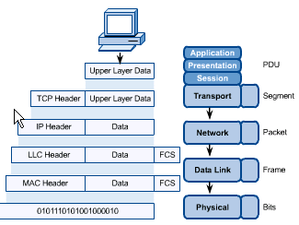
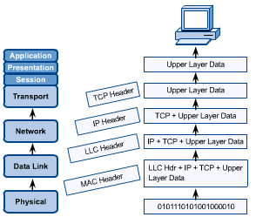
OSI MODEL
OSI in Action

Slide 12
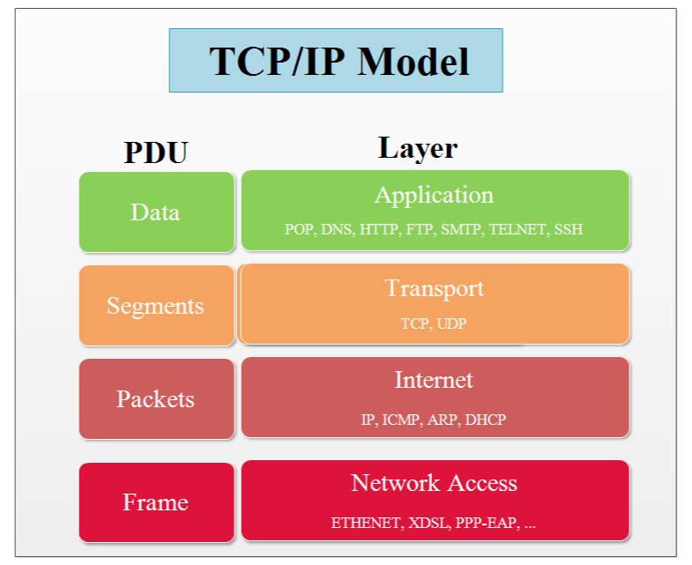
Layer of the TCP/IP Model
TCP/IP MODEL
Notes:
Tầng 1 : Network Access Layer (tầng truy cập) có thể coi tầng truy cập là một tầng riêng biệt hoặc cũng có thể tách thành 2 tầng vật lý và tầng liên kết dữ liệu như trong mô hình OSI, tầng truy cập được sử dụng để truyền gói tin từ tầng mạng đến các host trong mạng. Thành phần tầng truy cập bao gồm cả các thiết bị vật lý ( hun, switch, cáp mạng, card mạng HBA-Host Bus Adapter và các đặc tả mức thấp như tín hiệu điện.
Tầng 2 : Internet Layer (tầng mạng) Nhiệm vụ của tầng mạng trên mô hình TCP/IP là giải quyết vấn đề dẫn các gói tin đi qua các mạng để đến đúng đích mong muốn.
Tầng 3 : Transport Layer (tầng vận chuyển) cũng giống với tầng vận chuyển của mô hình OSI, tầng vận chuyển làm nhiệm vụ phân nhỏ các gói tin có kích thước lớn khi gửi và tập hợp lại khi nhận, đảm bảo tính toàn vẹn cho dữ liệu (không lỗi,không mất, không lặp, đúng thứ tự).
Tầng 4 : Application Layer (tầng ứng dụng) là nơi các chương trình mạng như Web Browser, Mail User Agent làm việc để liên lạc giữa các node mạng. Do mô hình TCP/IP không có tầng nào nằm giữa tầng ứng dụng và tầng vận chuyển , nên tầng ứng dụng của mô hình TCP/IP bao gồm cả các giao thức hoạt động như tầng trình diễn và phiên trong mô hình OSI. Việc này thường do người lập trình viên thực hiện.

Slide 13
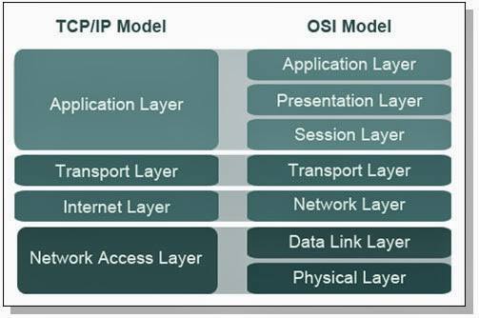
OSI & TCP / IP MODEL
OSI & TCP/IP Model
Notes:
* Giống nhau:
- Đều được chia thành các tầng.
- Đều có tầng ứng dụng, dù chúng bao gồm các dịch vụ khác nhau.
- Đều có lớp/tầng vận chuyển, mạng tương đương.
* Khác nhau:
- Mô hình TCP/IP gộp các vấn đề của tầng trình diễn và phiên vào trong tầng ứng dụng của nó.
- Mô hình TCP/IP gộp tầng vật lý và liên kết dữ liệu của mô hình OSI thành 1 tầng.
- Mô hình TCP/IP trông đơn giản hơn vì có ít tầng hơn.
- Các mạng thực tế không được xây dựng dựa trên mô hình OSI, mặc dù mô hình OSI được sử dụng để tham chiếu.

Slide 14
THE PROTOCOL, SERVICE IN APPLICATION
Web Service: HTTP và HTTPS.
Web services: is service link hypertext page. Used to transmit information to the users a rich and diverse ways.
Web services use 2 ways to send data to the user's HTTP (not secure) and HTTPS (secure).
Web services to work it must have 2 components: the Web Server and Web Client.
+ The Web Server provides Web data. People build up a Website for users to access. The Web Server will run in Port 80 or 443.
+ Web Client is the user. Users who open the IE or Firefox to access the domain name of the Web site.

Slide 15
THE PROTOCOL, SERVICE IN APPLICATION
The process of Web Service.
+ Step 1: Users access the website domain name in the browser.
+ Step 2: IE or Firefox will produce a high Port at the same time the data will transfer to the Transport Layer. At the same time the browser will request a favor to DNS Client domain name resolution out the Web Server IP address.
+ Step 3: Transport Layer will see the data as Web, it will receive by Port 80 or 443 then close TCP and then transmitted down under.
+ Step 4: Data will be closed the Network Layer IP host themselves and IP of Weh Service.

Slide 16
THE PROTOCOL, SERVICE IN APPLICATION
The process of Web Service.
+ Step 5: After the data to the Web Server is going up according to Port 80 or 443. Then the data is closed and sent down the line
+ Step 6: When the client receives it will switch to IE right into hight Port when initialized (Because of have high port so so we can Port to open multiple Windows on a browser with many different Website without fear of infection.

Slide 17
THE PROTOCOL, SERVICE IN APPLICATION
Mail Service: SMTP, POP, IMAP
Mail Service: is the email service. Instead of the contents of your message are written onto paper and moved via post then the email is saved as text files on your computer and be moved via the Internet.
Mail service need to have 2 components is: Mail Server and Mail Client.
+ Mail Server: used to receive mail from users and Mail Transfer.
+ Mail Client: use to send mail to a user's Mail Server goes up and receive from the Server about to show to the user vie. Mail Client using SMTP, POP, IMAP protocols.

Slide 18
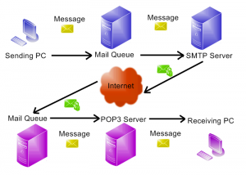
THE PROTOCOL, SERVICE IN APPLICATION
The process of sending and receiving of Mail Services
Notes:
- Các bước hoạt động:
+ Bước 1: Mail Client gửi mail lên Server bằng giao thức SMTP thông qua Port 25
+ Bước 2: Mail Server sẽ nhận mail từ Client bằng giao thức SMTP thông qua Port 25.
+ Bước 3: Mail Server sẽ nhờ DNS Client của mình gửi tới DNS Server để phân giải từ tên miền Mail (vd:mail.google.com) ra địa chỉ IP của Mail Server đó.
+ Bước 4: Sau khi có địa chỉ IP của Mail Server kia thì Mail Server sẽ liên lạc trực tiếp, rồi gửi và nhận Mail từ Mail Server đó qua Port 25 bằng giao thức SMTP. Sau đó sẽ chuyển sang Mail Box thông qua MDA để người dùng lấy về.
+ Bước 5: Người dùng sẽ lấy Mail từ trong Mail Box thông qua giao thức POP3 hoặc IMAP
Trong Mail Server có 2 thành phần chính là MDA (Mail Transfer Agent) dùng để quản lý mail, MTA (Mail Delivery Agent) dùng để gửi và nhận mail.

Slide 19
THE PROTOCOL, SERVICE IN APPLICATION
DNS Service
DNS services: is a domain name resolution service has a hierarchical database, distributed. Containing the same time dispersion mechanism of mapping from the domain name to the IP address and vice versa. To use the DNS Port is 53.
DNS Servicc need to have 2 components is: DNS Server and DNS Client.
DNS Server used to resolve domain names to IP and back out as IP to domain name. DNS Server using the Protocol is TCP and UDP
DNS Client used to resolve to the user's computer. When users access the domain name DNS Client will request a favor to the DNS Server resolution.
Notes:
+ TCP dùng để đóng gói khi 2 Server DNS trao đổi dữ liệu với nhau. Đảm bảo an toàn cho dữ liệu.
+ UDP dùng để đóng gói khi Client yêu cầu phân giải tên miền

Slide 20
THE PROTOCOL, SERVICE IN APPLICATION
Active Process of DNS Service
+ Step 1: On your computer users visit the Website: htttp://google.com.vn in IE. IE request a favor to DNS Client name resolution google.com.vn domain to the IP address.
+ Step 2: Packets of the DNS client will be forwarded to the Transport Layer and will be encapsulation with UDP protocol. Then switch to the Network.
+ Step 3: Network will close your computer's IP is source IP, destination IP is the IP DNS Server.
+ Step 4: Data will be moved down to the floor below and transmit correct DNS Server.
+ Step 5: When the request to the DNS server it will look in your database view that domain name's IP address Server to any Website.
+ Step 6: After finding it will send back to the machine have the DNS Client requests.
+ Step 7: IP of the Website ready for Network layer packing layer of packet data access Website

Slide 21
THE PROTOCOL, SERVICE IN APPLICATION
DHCP Service
DHCP service that is service allocated a dynamic IP address.
DHCP service need to have 2 components: DHCP Server and DHCP Client.
+ DHCP Server is used to allocate dynamic IP using Port 67. Send or receive IP information is in this Port.
+ DHCP Client is used to receive IP or please allocation ip both use Port 68.

Slide 22
THE PROTOCOL, SERVICE IN APPLICATION
Active Process of DHCP Service
Step 1: DHCP Client will sends a Broadcast message was Discover. This message request for IP address and will be received by the port 68 of Transport Layer then packing by UDP and then transmitted down under. Network Access layer will packing the source MAC address is your client and destination MAC is MAC Broadcast. Due to the Broadcast MAC address so all the machines in the network receive, including your DHCP Server.
- Step 2: after the DHCP Server receives the packet it will be Network Access layer will move up the top to handle. Transport layer will receive information and then move up to Port 67 for Application layer.
Notes:
Các bước hoạt động:
+ Bước 1: DHCP Client sẽ gửi một bản tin Broadcast là Discover. Bản tin là thông tin yêu cầu xin địa chỉ IP. Bản tin sẽ được tầng Transport nhận bằng cổng 68 sau đó đóng gói bằng giao thức UDP rồi truyền xuống dưới. Tầng Network Access sẽ đóng địa chỉ MAC nguồn là máy mình và MAC đích là MAC Broadcast rồi chuyển ra đường truyền. Do có địa chỉ MAC là Broadcast nên tất cả các máy trong mạng đều nhận được, trong đó có máy DHCP Server.

Slide 23
THE PROTOCOL, SERVICE IN APPLICATION
Active Process of DHCP Service
- Step 3: After the DHCP Server handle, the Server will send back a newsletter Offer includes the IP address information for your Client And then move down to the Transport layer packing by the port 67. Transport layer will packing by UDP and continue moving down to packing the source MAC address and destination MAC address. Next data will send out the line.
- Step 4: Client receive data from Port 68 and put the IP in DHCP Client. The DHCP Client then sends back a message Request is agreed to use that IP to DHCP Server validation
- Step 5: DHCP Server receives information from the DHCP Client sends back an ACK message to confirm that the process was successful.

Slide 24
THE PROTOCOL, SERVICE IN APPLICATION
TELNET Service
TELNET is a user command and an underlying TCP/IP protocol for accessing remote computers. Through Telnet, an administrator or another user can access someone else's computer remotely.
We can also understand the Telnet is a Client-Server protocol based on TCP, and the Client typically connects to port 23 of a Server.
Telnet does not encrypt data transmitted through the connecting lines, including the password, so the stolen information is relatively easy. Telnet lacks user authentication

Slide 25
TCP / UDP PROTOCOL OF THE TRANSPORT LAYER
TCP – UDP Protocol
TCP (Transmission Control Protocol) - "Giao thức điều khiển truyền vận") is one of the core protocols of the TCP/IP protocol. Using TCP, the application on the server are networked can create "connections" with each other, through which they can exchange data or packets. The Protocol to ensure data transfer to get a credible way and in the right order.
UDP (User Datagram Protocol) is one of the core protocols of the TCP/IP protocol. Using UDP, the program on the computer networks that can send short data is called “datagrams” to other machines. UDP does not provide confidence and order transmission, the packets may arrive incorrect order or lost without notice. However the fast and efficient for UDP with the small size packages and strict requirements on time.

Slide 26
TCP / UDP PROTOCOL OF THE TRANSPORT LAYER
Comparison between the TCP & UDP Protocol
Same: is the network protocol TCP/IP, both have the function to connect the machines together, and can send data to each other. ...
Different: The TCP and UDP header vary in size (20 and 8 bytes), the cause is mainly due to TCP to support many more useful functions (such as error recovery capabilities). UDP uses less bytes than for the header and the request from the host processor for less than
TCP : Used for the WAN - Do not allow the packet loss Ensure the transmission of data Lower transfer speed UDP | UDP: - Used for the LAN - Allow the packet loss - Do not transmission of data - High transmission speed

